Slide 1
Image based Animal Type Classification for cattle and buffaloes
CSE7302- University Project
Review-1
Batch Number : CDV_8
Under the Supervision of,
Mr. Sahabzada Betab Badar
Assistant Professor
School of Computer Science and Engineering
Presidency University
Roll Number | Student Name
20221CDV0026 | Harshitha KJ
20221CDV0038 | Susmitha S
20221CDV0040 | Greeshma
Name of the Program: CDV
Name of the HoD: Dr. Pravinthraja S
Name of the Program Project Coordinator: Dr. H M Manjula
Name of the School Project Coordinators: Dr. Sampath A K , Dr. Geetha A

Slide 2
Content
Introduction
Literature Survey
Research Gap
Proposed System Design
Tools & Technologies

Slide 3
Introduction:
Livestock such as cattle and buffaloes play a vital role in agriculture, dairy production, and the rural economy.
Proper identification of animal type is important for farm management, breeding, health monitoring, and insurance.
With the growth of artificial intelligence, computer vision can be used to automatically identify animals
from images.
Image-based classification helps in distinguishing between cattle and buffaloes based on their visual features.
This system uses digital images of animals as input for classification.
Machine learning and deep learning techniques analyze patterns such as shape, texture, horns, and
body structure.
Once trained, the system can predict the animal type when a new image is given.
This approach reduces manual effort and improves accuracy and efficiency.

Slide 4
Literature Review
Recent research demonstrates that Convolutional Neural Network (CNN) based deep learning models are highly effective for livestock image classification, achieving good accuracy in identifying animal species such as cows, buffaloes, sheep, and goats.
Most existing studies primarily focus on animal type identification or breed classification using supervised learning techniques. These works mainly address classification accuracy but do not extend toward complete livestock management solutions.
Only a limited number of studies attempt health analysis using visual features, and even these are restricted to basic symptom detection without systematic validation or explainability.
Additionally, many current livestock management systems rely on manual record keeping or RFID-based identification, which increases operational cost, requires physical tagging, and is prone to duplication, data inconsistency, and human error.
Very few systems incorporate duplicate detection mechanisms to prevent multiple registrations of the same animal. Moreover, the use of Explainable Artificial Intelligence (XAI) techniques to justify AI decisions is largely absent in existing research.
Inference: From the literature survey, it is evident that current solutions are fragmented, feature-specific, and not system-oriented, highlighting the need for an integrated, explainable, and end-to-end AI-based livestock identification and analysis system.

Slide 5
Research Gap & Motivation
Identified Research Gaps
Existing systems do not provide a unique and persistent digital identity for each livestock animal.
There is no effective duplicate or fraud detection mechanism, leading to multiple registrations and misuse of records.
Health analysis is either very limited or completely absent, especially in terms of visual health risk indicators.
Most models operate as black boxes, lacking Explainable AI (XAI) features to justify predictions and build user trust.
Current solutions are not end-to-end systems; they lack proper integration of AI models, user interface, and database management.
Motivation
The motivation of this work is to design and develop a complete AI-based smart livestock identification system that integrates deep learning, image processing, explainable AI, and database management to provide an accurate, transparent, and scalable solution for real-world livestock management.

Slide 6
Proposed System Overview
AI-Based Smart Livestock Identification System
The proposed system is an intelligent, image-based livestock identification platform that utilizes deep learning and computer vision techniques to automate livestock analysis and management.
Key Features
Animal Type Identification: Automatic classification of livestock as cow or buffalo
Breed Classification: Identification of specific breeds using deep learning models
Digital Profile Creation: Creation of a unique digital identity for each animal, including image and metadata
Duplicate Detection: Prevention of multiple registrations using image feature similarity analysis
Visual Health Risk Analysis: Detection of basic health risk indicators from visible features
Explainable AI: Generation of heatmaps to visually explain AI decision-making
Approach
The system follows an image-based automated analysis approach, where livestock images are processed through a CNN-based deep learning model to perform classification, analysis, and decision support with improved accuracy and transparency.

Slide 7
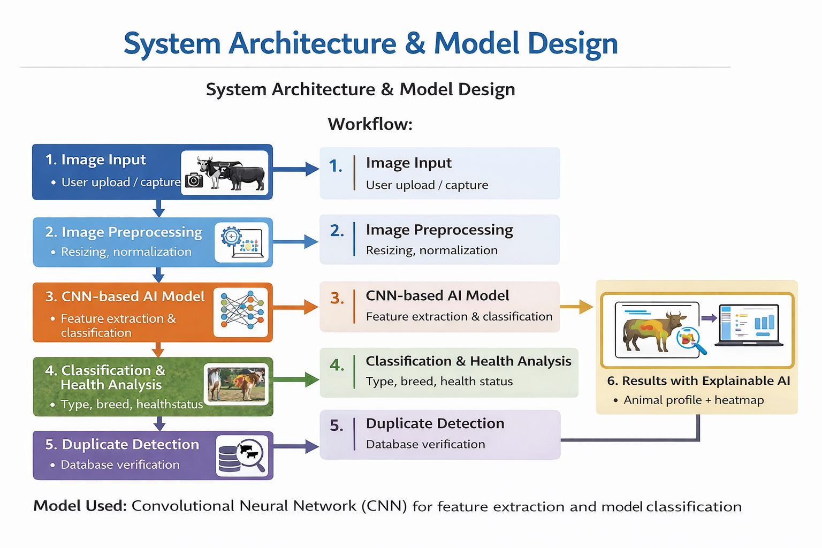
System Architecture & Model Design
Workflow:
Image Input
Image Preprocessing
CNN-based AI Model
Classification & Health Analysis
Duplicate Detection
Results with Explainable AI
Model Used:
Convolutional Neural Network (CNN) for feature extraction and classification
FIG 1: System Architecture and Model Design of AI-Based Smart Livestock Identification System

Slide 8
Tools & Technologies Used
AI & Image Processing
Python – Core programming language
TensorFlow / PyTorch – Deep learning frameworks
Convolutional Neural Networks (CNN) – Image feature extraction and classification
OpenCV – Image preprocessing and enhancement
User Interface
Flutter / ReactJS – User-friendly interface for image upload and result display
Database
SQLite / PostgreSQL – Storage of animal images, profiles, and metadata
Visualization
Heatmaps (Explainable AI) – Visual explanation of AI predictions
Result Dashboards – Display of classification and health analysis outputs

Slide 9
Outcome & Conclusion
Outcome
Comprehensive literature survey completed and research gaps clearly identified
Limitations of existing livestock identification systems analyzed
Proposed system architecture finalized based on identified gaps
CNN-based AI model design validated for classification and feature extraction
Health risk analysis and duplicate detection concepts finalized
Explainable AI approach selected to improve transparency and trust
Tools and technologies finalized for implementation phase
Conclusion
The proposed AI-based smart livestock identification system provides a scalable, reliable, and explainable solution to real-world livestock management challenges. By integrating deep learning, image processing, database management, and explainable AI, the system overcomes the limitations of traditional and existing automated approaches. The finalized design is technically feasible, academically strong, and suitable for practical deployment, making it well-aligned with the objectives of the project and ready for implementation in the next phase.

Slide 10


